Slide 1


Exploratory Data Analysis of
Hotel Booking Dataset
Presentation: First Task
Group : ML_Group2
Submitted By: Dalia Nasser

Slide 2
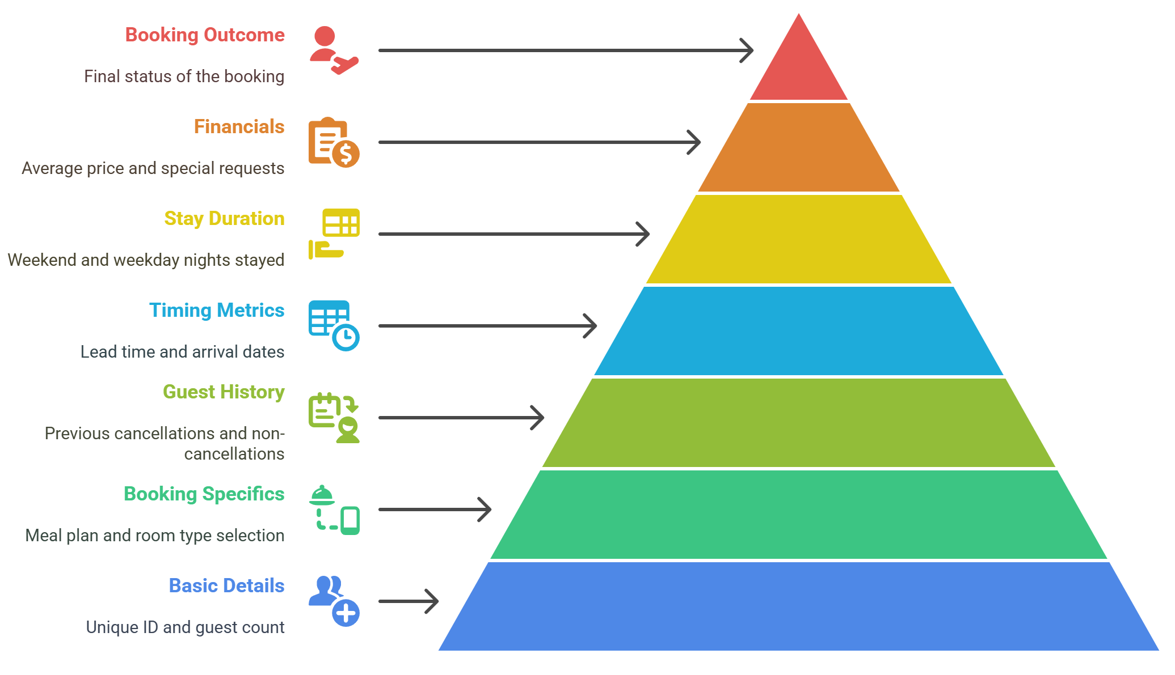
Overview about the Project
Key Features and Their Descriptions
The dataset used in this project consists of 36,285 hotel booking records, each representing an individual reservation made by a guest. It includes 19 attributes covering a wide range of booking-related information such as guest composition, stay duration, pricing, preferences, and booking behavior.

Slide 3
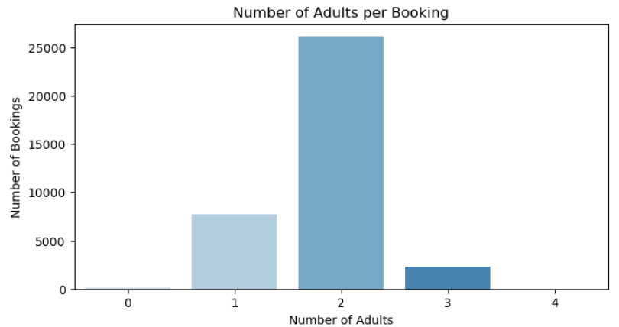
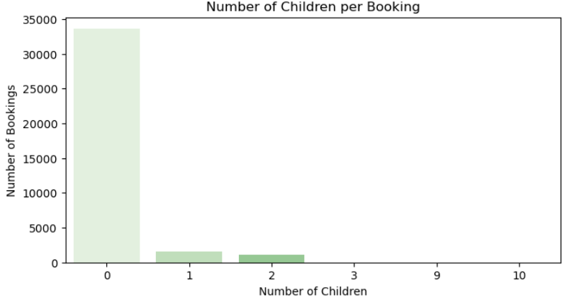
Number of adults Vs. Number of children
Most hotel bookings were made for 2 adults without children, indicating that the majority of guests are likely couples or business travelers, while bookings involving children are relatively less frequent.

Slide 4
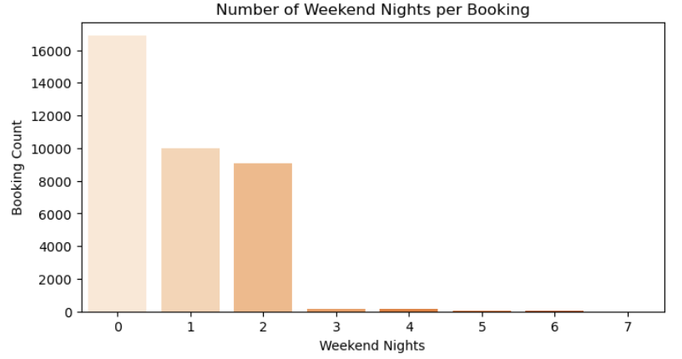
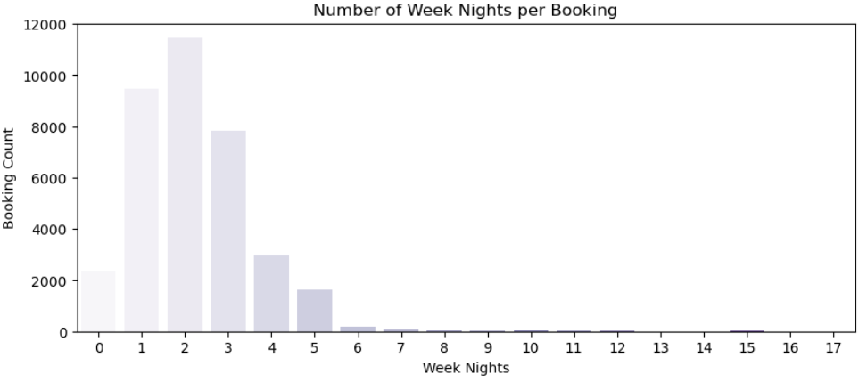
Number of weekend nights Vs. Number of weekdays
Most guests booked stays that included 0 to 2 weekend nights. Weekday bookings peaked at 1–3 nights, suggesting that most visitors plan short business or midweek leisure trips. Longer stays (over 5 nights) were relatively rare for both weekdays and weekends.

Slide 5
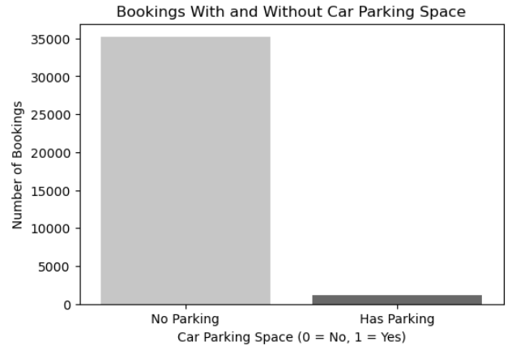
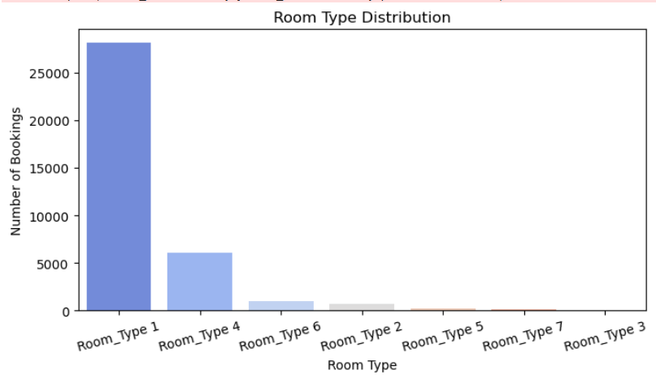
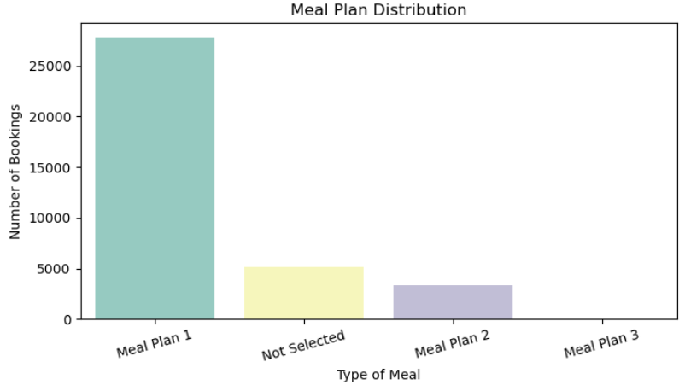
How many Booking include parking space?
What types of rooms were booked most frequently?
How are meal distributed among bookings?
Most guests did not request parking, suggesting reliance on public transport or walk-ins.
Room Type 1 is the most booked, indicating it fits general customer needs.
A specific meal type (Meal Plan 1) is most popular, possibly bundled in packages.

Slide 6
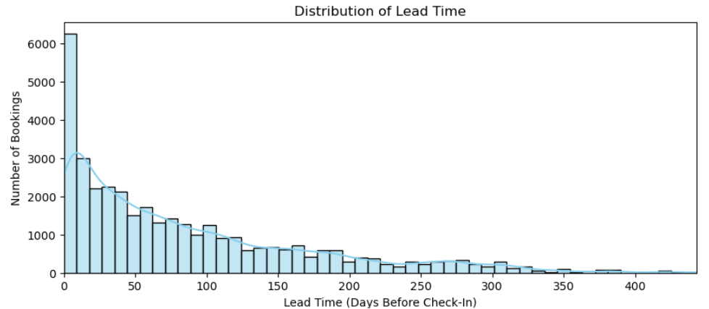
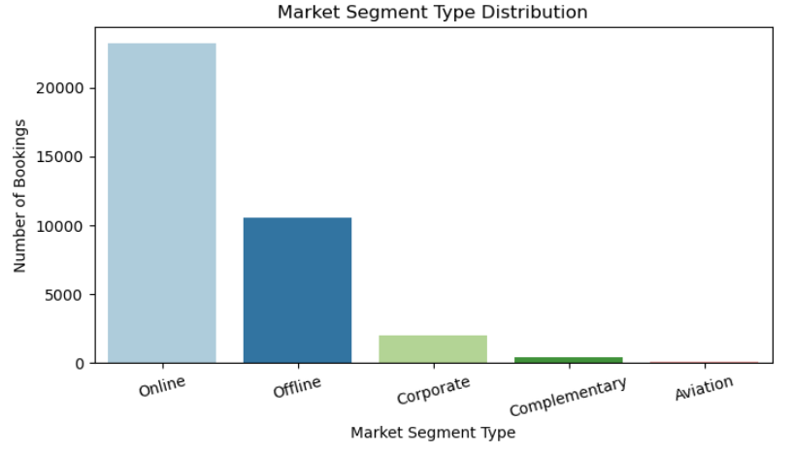
What is the distribution of lead time before arrival?
Many bookings are made close to the stay date, but there's a long tail of early reservations, showing a mix of planners and last-minute guests.
Which market segment contributed most to bookings?
Online bookings dominate, followed by offline and corporate channels.

Slide 7
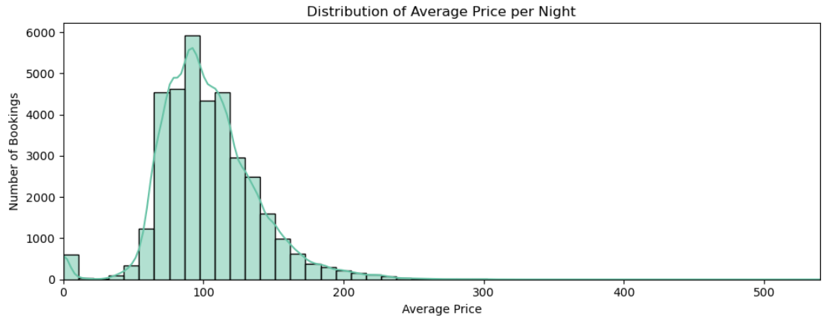
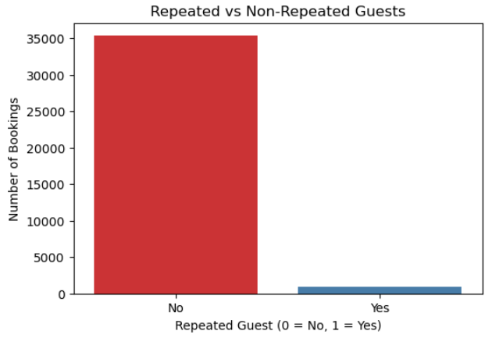
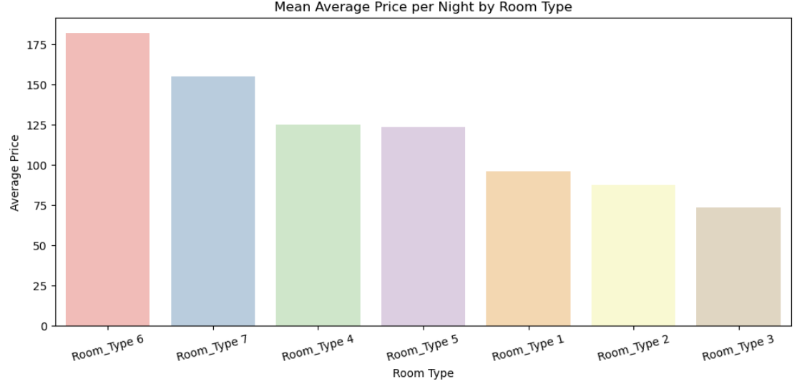
How does average price vary by room type or booking status?
Are there repeat customers?
Premium rooms have higher average prices, and some bookings with higher prices tend to cancel more often.
Majority of guests are new customers, with repeat visitors making up a small percentage.

Slide 8
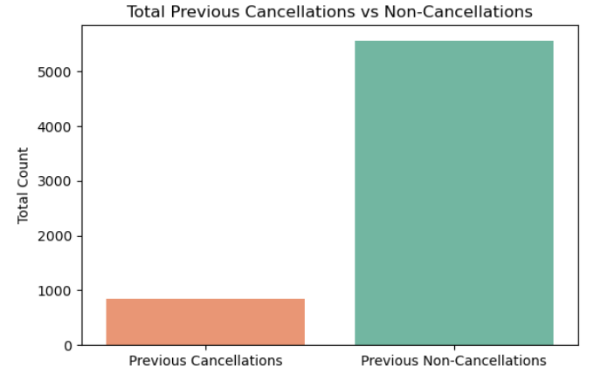
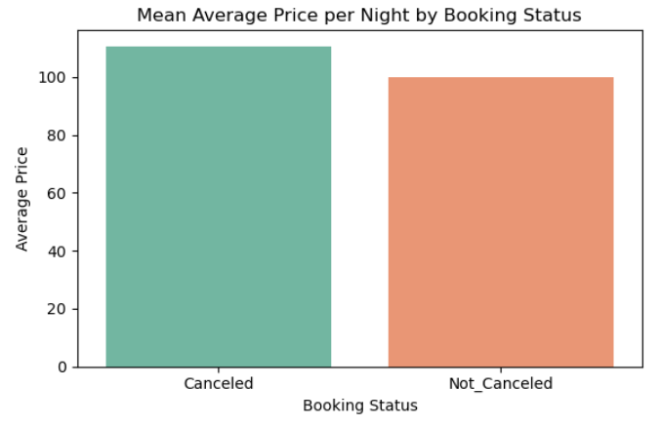
What does the history of previous cancellations tell us about guest behavior?
A large majority of guests have no prior cancellations, suggesting that most customers are reliable and only a minority show cancellation tendencies.
Do price levels affect whether a booking gets canceled?
Bookings that were canceled had a slightly higher average nightly price than those confirmed, indicating that higher pricing may influence cancellation decisions, possibly due to cost reconsideration.

Slide 9
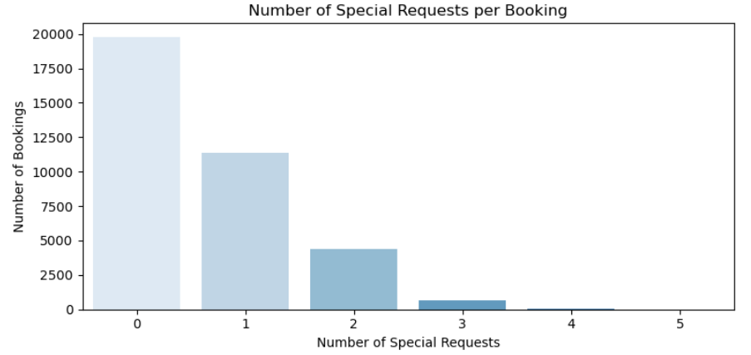
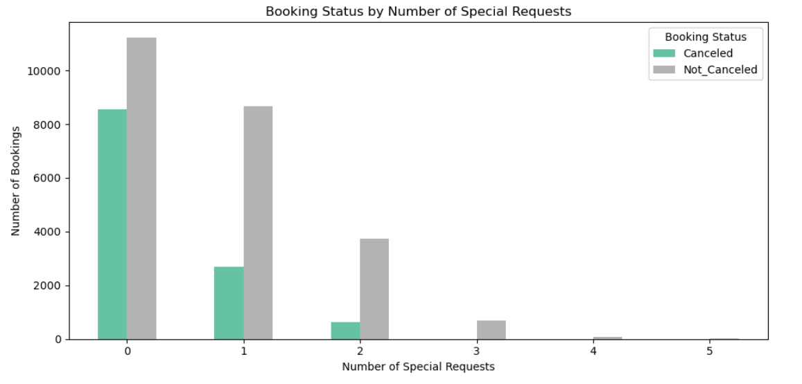
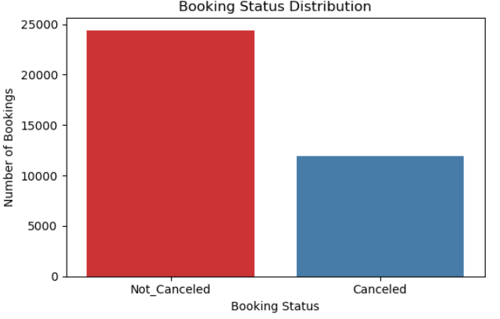
How common are special requests among hotel bookings?
Does the number of special requests influence booking cancellation?
What is the overall cancellation rate of hotel bookings?
The majority of bookings were made with no special requests, and only a small fraction included 2 or more requests, indicating that most guests have standard needs, while only a few seek personalized accommodations.
Bookings with 0 or 1 special request show a higher cancellation rate, while bookings with 2 or more requests are rarely canceled, suggesting that guests with specific needs are more likely to follow through with their stay.
The majority of bookings are not canceled, indicating strong customer retention. However, with a significant portion still being canceled, there's room to explore factors driving cancellations (like price, lead time, or lack of special requests).

Slide 10
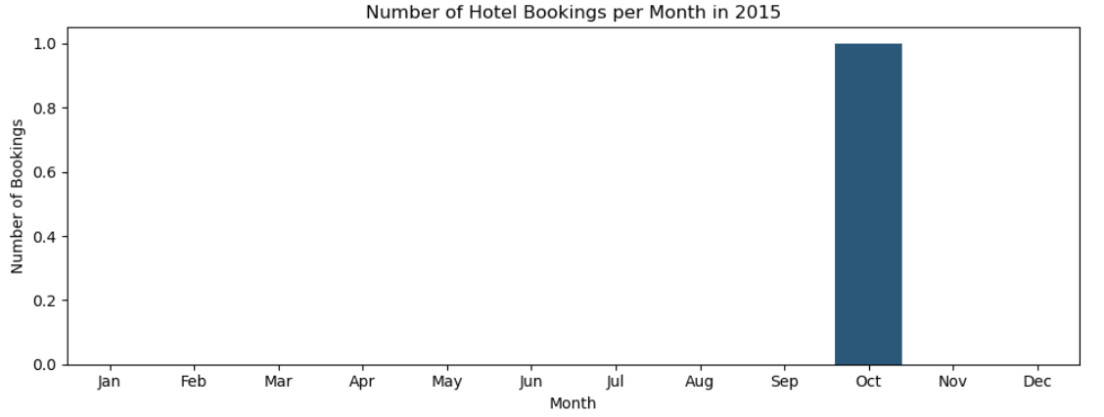
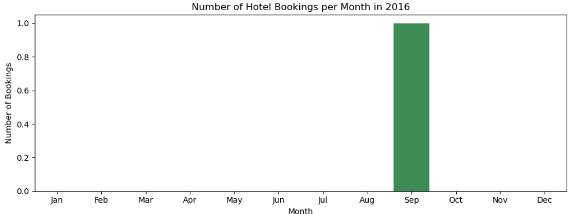
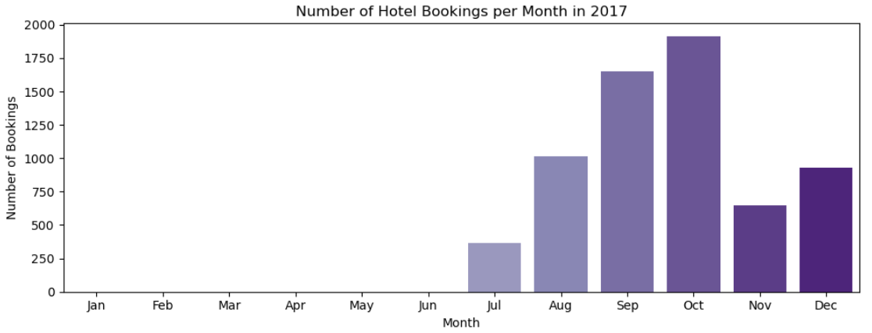
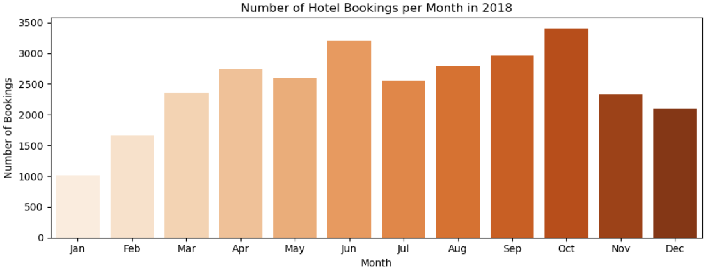
How have hotel bookings evolved across the months from 2015 to 2018?
There is a clear growth in bookings year over year, with 2018 showing consistent and strong booking activity throughout the year, especially in October and June. In contrast, 2015 and 2016 had very limited bookings, possibly due to partial data or low operations. The peak booking months consistently fall between June and October, indicating a strong seasonal demand during the summer and early fall.

Slide 11
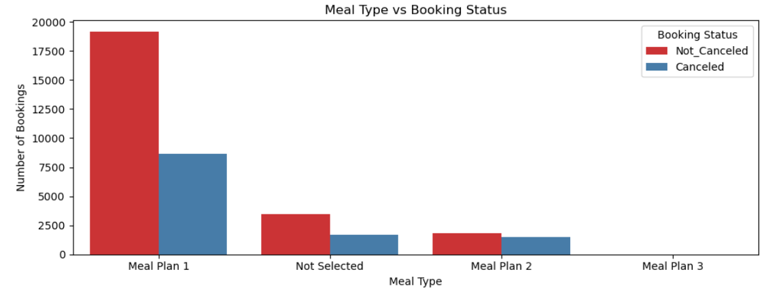
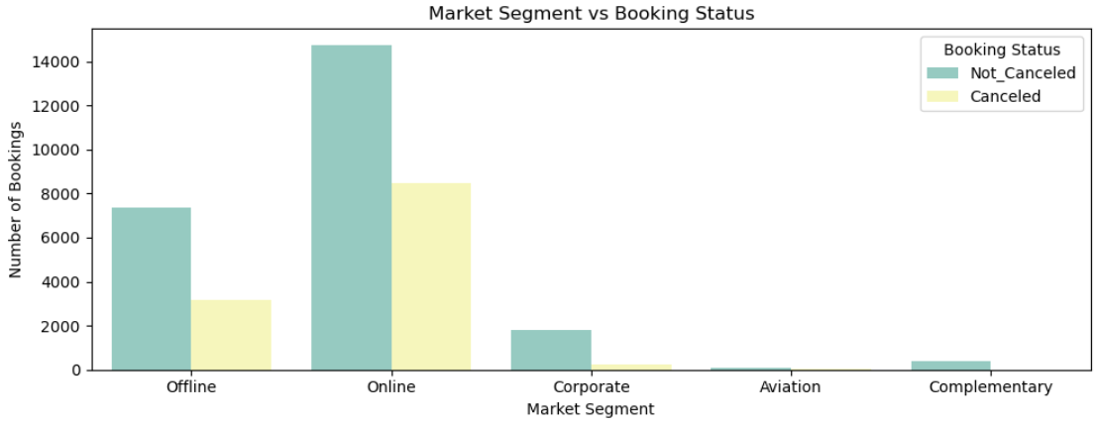
How does the type of meal plan selected influence booking cancellations?
Meal Plan 1 is the most popular and shows the highest number of both confirmed and canceled bookings, likely because it's the default or most economical option. Interestingly, Meal Plan 2 and Not Selected have relatively balanced cancellation rates, suggesting that guests who skip or select alternative meal plans might have higher uncertainty or flexible travel plans. Meal Plan 3 is nearly unused, indicating low preference or availability.
Which market segment contributes most to cancellations, and which shows more reliable bookings?
The Online segment has the highest number of both bookings and cancellations, indicating a broad reach but also greater unpredictability. In contrast, Corporate and Offline segments show a higher rate of completed bookings with fewer cancellations, suggesting more stable and committed customer groups.

Slide 12
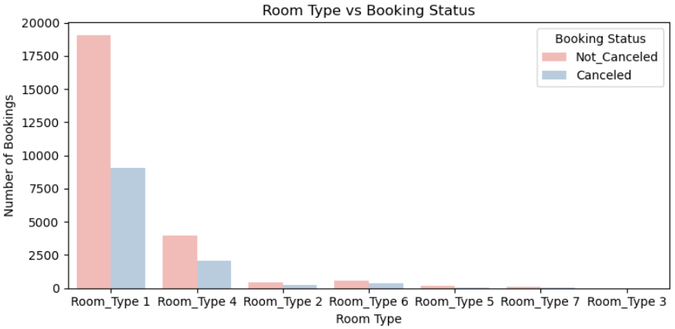
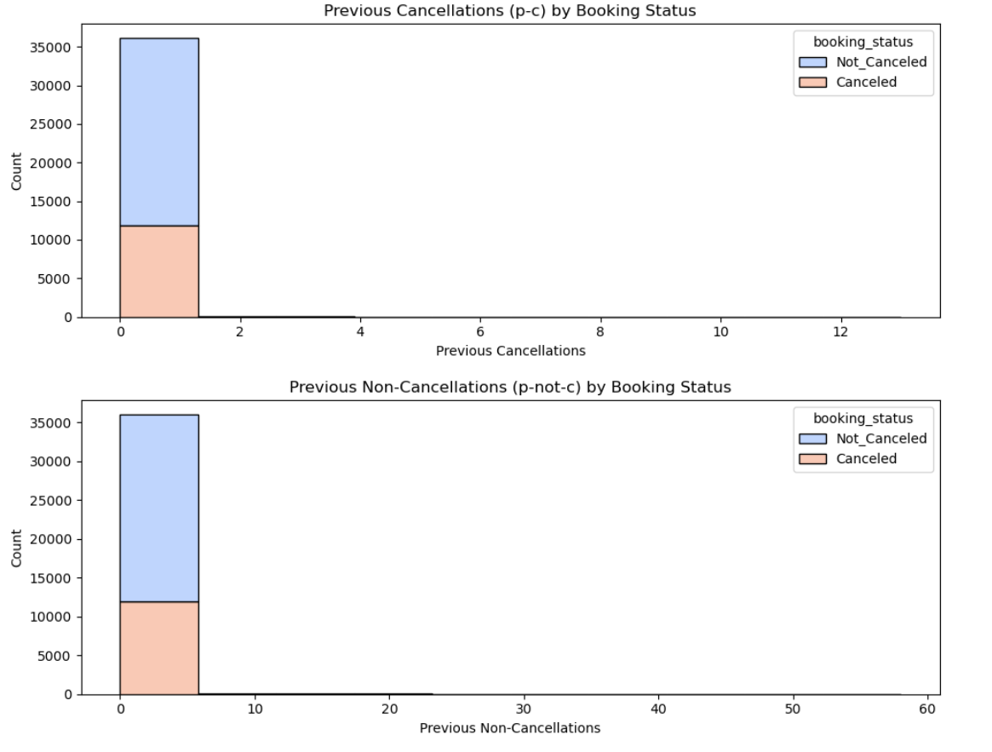
Which room types are most frequently booked and how do they relate to cancellations?
How do a guest’s past cancellation and non-cancellation history influence their likelihood to cancel future bookings?
Room_Type 1 dominates in total bookings and also has the highest number of cancellations, likely due to its popularity. However, other room types such as Room_Type 3 and Room_Type 7 show very low booking and cancellation activity, indicating limited demand or availability
Guests with no prior booking history neither cancellations nor non-cancellations—form the majority, yet they still contribute significantly to both current cancellations and confirmations. However, guests with a history of confirmed bookings (non-cancellations) are more likely to keep their reservations, suggesting that previous booking behavior is a strong indicator of future reliability.

Slide 13
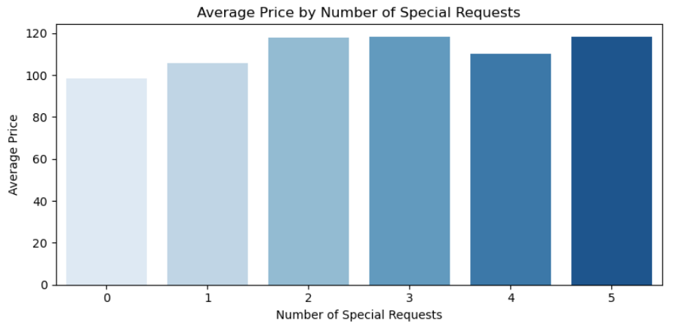
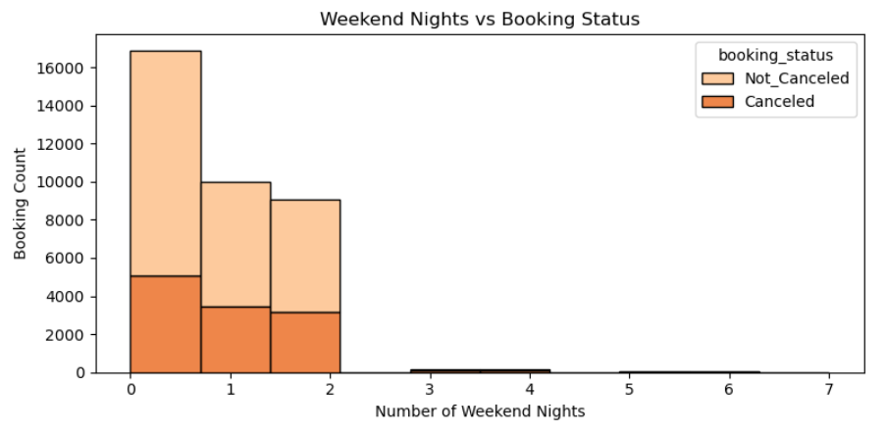
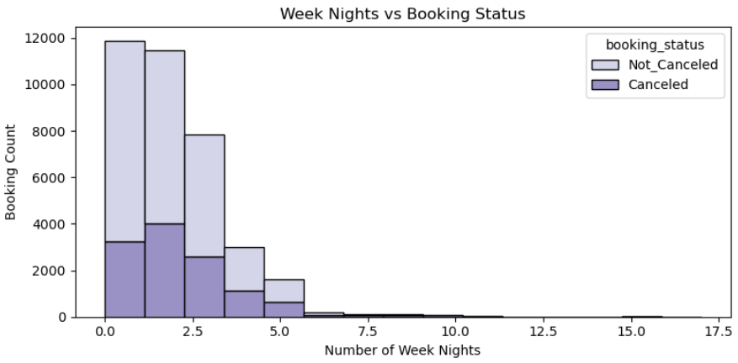
How does the number of special requests impact the average price per night?
What is the relationship between the number of weekend nights and booking cancellations?
How does the number of weeknights in a booking affect the cancellation rate?
As the number of special requests increases, the average price per night also tends to rise—indicating that guests making more requests often book higher-tier rooms or premium services. This suggests a link between personalized services and higher revenue per booking.
Most bookings involve 0–2 weekend nights, and within these, non-canceled bookings consistently outnumber canceled ones. This suggests that weekend duration has minimal influence on cancellation, with short stays being the most common and stable.
Bookings with 1 to 3 weeknights are the most common, and non-cancellations dominate across all durations. However, as the number of weeknights increases, the frequency of bookings and cancellations decreases sharply, indicating that longer stays are less popular and may carry a slightly higher risk of cancellation.

Slide 14
Thank You

